Slide 1

Group 2: Seminar on ”The Future of the Internet”, unit 6
Marianne Lyne Manaog

Slide 2

Allocated group’s position
“It is our belief that the future of the internet is based on peer-to-peer overlay-based networking (BitTorrent, TOR, Freenet, KAD).”

Slide 3
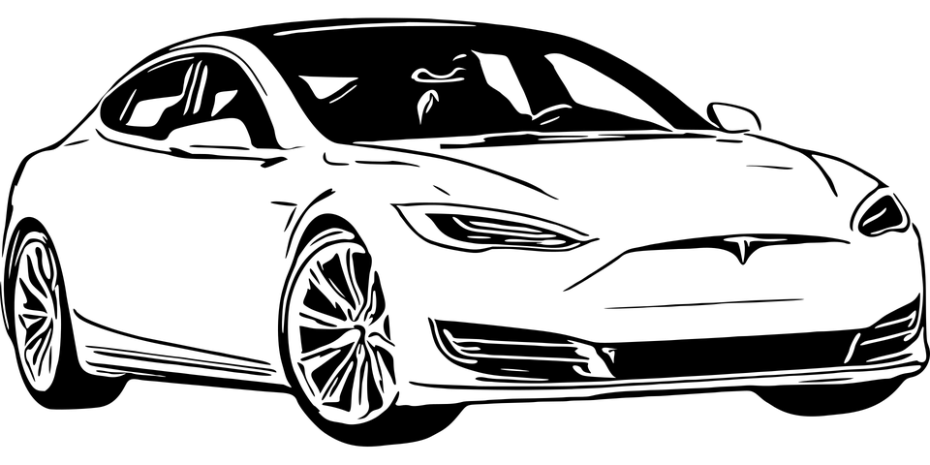
Opening argument in support of group’s position
With the rise of autonomous vehicles (An et al., 2019), peer-to-peer overlay-based networks can enable to securely share data between vehicles on the same network, e.g., within Tesla’s or Uber’s cars, that can help passengers share travel-related details, receive up-to-date content on places they are visiting and access virtual entertainment too (Ameur et al., 2022).
Ameur, A. I., Lakas, A., Bachir, Y. M., & Oubbati, O. S. (2022) Peer-to-peer overlay techniques for vehicular ad hoc networks: Survey and challenges. Vehicular Communications, 100455.
An, S., Nam, D., & Jayakrishnan, R. (2019) Impacts of integrating shared autonomous vehicles into a peer-to-peer ridesharing system. Procedia Computer Science, 151, 511-518.

Slide 4

Peer-to-peer networking over MobilityFirst for autonomous vehicles
Although the MobilityFirst architecture can be made secure by leveraging PKI-based self-certifying addresses, its main drawback when applied to support networks of autonomous vehicles lies in its limited routing aggregation (Fang et al., 2018).
In fact, differently from the MobilityFirst approach, a peer-to-peer network can enable the aggregation of the itinerary-based intentions of autonomous vehicles to help in predicting future traffic-related conditions and, thus, managing them more effectively (Varga, 2022).
Fang, C., Yao, H., Wang, Z., Wu, W., Jin, X., & Yu, F. R. (2018). A survey of mobile information-centric networking: Research issues and challenges. IEEE Communications Surveys & Tutorials, 20(3), 2353-2371.
Varga, L. Z. (2022). Solutions to the routing problem: towards trustworthy autonomous vehicles. Artificial Intelligence Review, 1-40.

